Slide 1
Anomaly diagnosis method-22/09/2023
09.2023

Slide 2
Content
Key Idea
Dataset : BasicMotions
Description
Pre-process
CNN+LSTM
CNN
MLP
Next Step

Slide 3
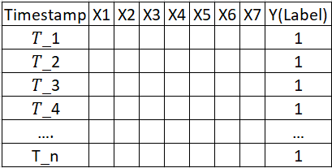
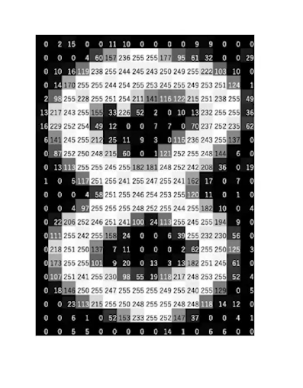
Key Idea
Problem Define : Determine the corresponding root cause (output) for a given abnormal input
Aim : Build Time Series Classification model , each parameters has own classification model
Key idea: Each time series sequence is transformed into a 2D image-like representation.
Pattern Recognition: By using a 2D image-like representation , we can uncover whether there are specific patterns within the time series that share the same root cause
Temporal Relationships: study the relationships and patterns between different variables over time
Each abnormal case is a grey scale picture

Slide 4
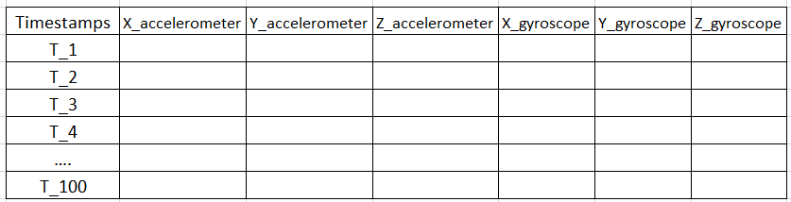
Dataset : BasicMotions-Description
The data was generated by four students performed four activities whilst wearing a smart watch. The watch collects 3D accelerometer and a 3D gyroscope.
The data order is accelerometer x, y, z then gyroscope x, y, z.
There are 4 classes: walking, resting, running and badminton.
Participants were required to record motion a total of five times, and the data is sampled once every tenth of a second, for a ten second period
Walking
Reference :UCR Time Series Classification datasets http://timeseriesclassification.com/index.php

Slide 5
Dataset : BasicMotions-Description
40 sample
(40,100,60)
Training Size | Test Size | Length | Number of classes | Number of Dimensions
40 | 40 | 100 | 4 | 6
Reference :UCR Time Series Classification datasets http://timeseriesclassification.com/index.php

Slide 6
Dataset : BasicMotions-Preprocess
Mapping Activities(Class) to Numbers : maps specific activity names (like "Standing", "Running", etc.) to numerical values (0, 1, 2, 3).
Normalization : The raw data ranges from negative to positive floating-point values. Min-Max scaling is applied to normalize this data.
Randomly shuffle data

Slide 7
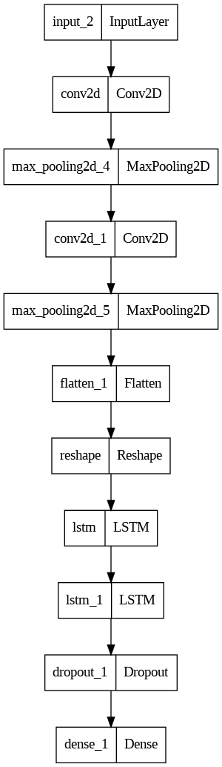
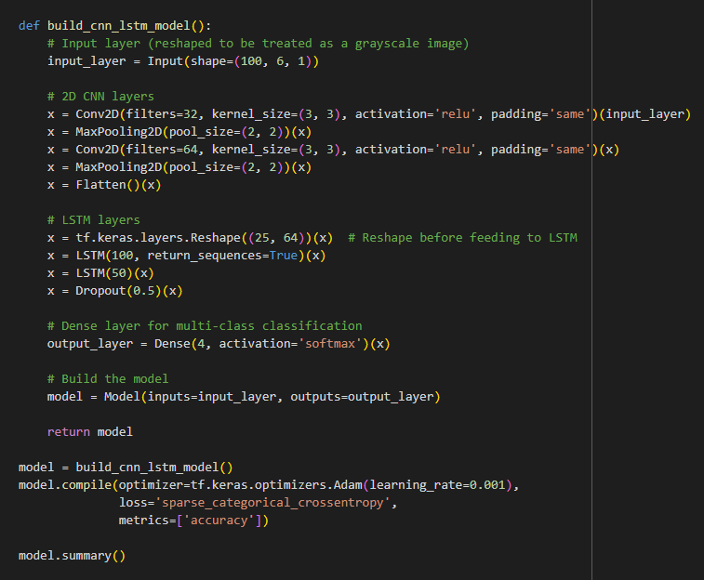
CNN+LSTM-Architecture

Slide 8
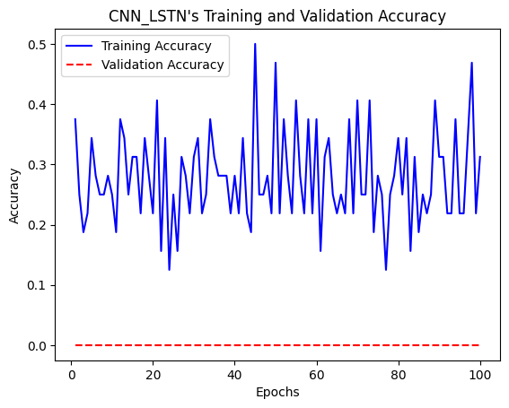
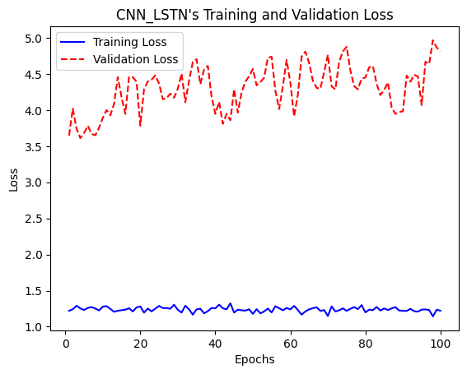
CNN+LSTM-Result
 | Training set | Validation set
Loss | 1.918753 | 1.918753
Accuracy | 0.250000 | 0.250000
Issue
training loss hasn't converged
training loss and validation loss is different

Slide 9
KerasTuner
How to decide hypermeter: KerasTuner
KerasTuner is a hyperparameter tuner, can find the optimal set of hyperparameters for model, it help us to learned hyperparameter from the data, such as the number of neurons in a layer, learning rate, batch size, and so on.
Base the following model's hyperparameters on the results from Keras Tuner.

Slide 10
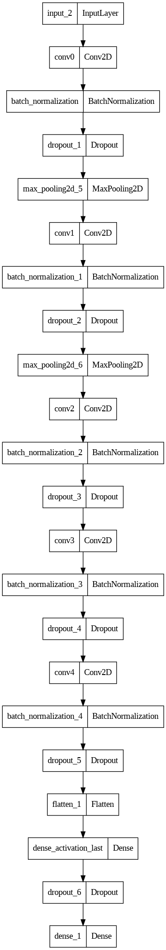
CNN-Architecture
Number of convolutional layers: 5
Regularization: l2
Conv0 filters: 48
Conv0 kernel size: 3
Conv0 activation: relu
Use batch normalization: True
Use dropout: True
Conv1 filters: 32
Conv1 kernel size: 3
Conv1 activation: relu
Use batch normalization: True
Use dropout: True
Conv2 filters: 32
Conv2 kernel size: 5
Conv2 activation: sigmoid
Use batch normalization: True
Use dropout: True
Conv3 filters: 32
Conv3 kernel size: 3
Conv3 activation: relu
Use batch normalization: True
Use dropout: True
Conv4 filters: 32
Conv4 kernel size: 3
Conv4 activation: sigmoid
Use batch normalization: True
Use dropout: True
Use cosine decay: True
Optimizer: sgd

Slide 11
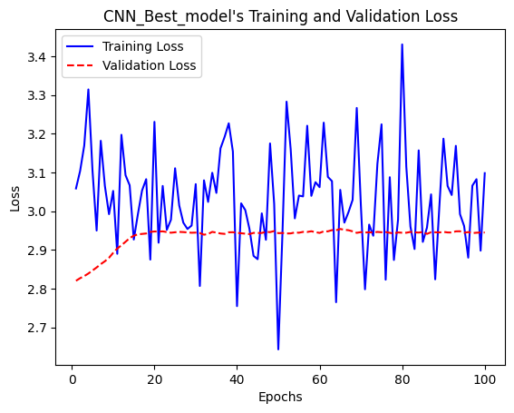
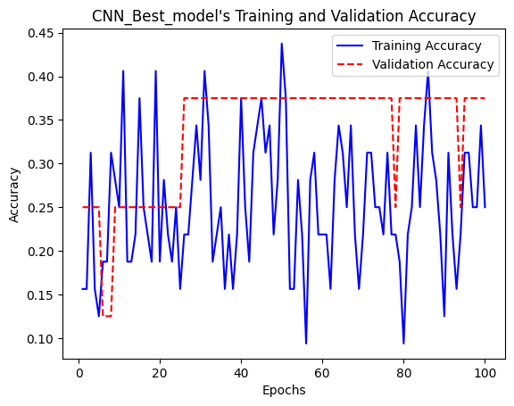
CNN-Result
Index | Training set | Validation set
Loss | 2.829637 | 2.829637
Accuracy | 0.250000 | 0.250000
The training loss fluctuates significantly and doesn't converge.
Before reaching 50 epochs, the loss does show slight convergence with its lowest value being below 2.7 (which is still too high). After 50 epochs, the loss begins to trend upward.

Slide 12
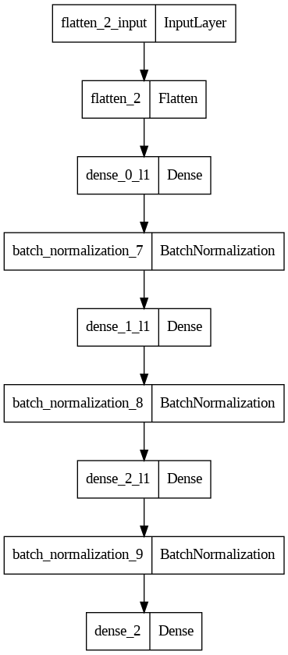
MLP-Architecture
Best number of hidden layers: 3
Best regularization: L1
Best number of filters for dense layer 0: 100
Best activation function for dense layer 0: tanh
Use BatchNormalization: True
Use Dropout: False
Best number of filters for dense layer 1: 110
Best activation function for dense layer 1: tanh
Use BatchNormalization: True
Use Dropout: False
Best number of filters for dense layer 2: 110
Best activation function for dense layer 2: tanh
Use BatchNormalization: True
Use Dropout: False
Use CosineDecay: False
Best optimizer: adam

Slide 13
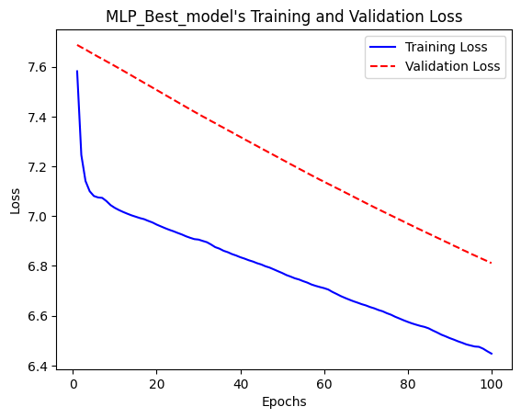
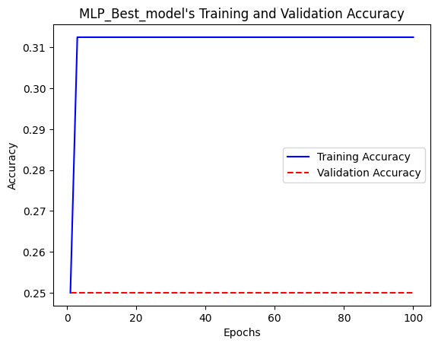
MLP-Result
Index | Training set | Validation set
Loss | 6.690022 | 6.689377
Accuracy | 0.250000 | 0.250000

Slide 14
Model- Comparsion
Index | CNN+LSTM | CNN | MLP
Training set Loss | 1.918753 | 6.689377 | 6.690022
Testing set Loss | 1.918753 | 6.689377 | 6.689377
Training set Accuracy | 0.250000 | 0.250000 | 0.250000
Testing set Accuracy | 0.250000 | 0.250000 | 0.250000
In summary, while the CNN+LSTM model has the lowest loss, all models have really low accuracy, which is a significant concern.

Slide 15
Next Step
Find a new dataset :
Train it using the same algorithms and model architectures.
This will serve as an A/B test to determine if the challenges in training arise from the dataset itself or from the chosen algorithm and model structures.
Given the small size of the dataset, it might lack discriminative power

